Slide 1
DIABETIC RETINOPATHY
FLAME Lecture: 13
Marshburn 10.29.18

Slide 2
LEARNING OBJECTIVES
To understand the pathophysiology of diabetic retinopathy
To recognize ophthalmic changes in patients with diabetic retinopathy
To describe prevention strategies and some treatments for retinopathy
Prerequisites:
  NONE
See also – for closely related topics
  FLAMEs on Type 2 DM

Slide 3
PATHOPHYSIOLOGY
It is difficult to predict the development of retinopathy in populations; however, hyperglycemia is known to cause vessel proliferation and optic nerve damage
To reduce risk, it is important to maintain good glycemic control.
Lower hemoglobin A1C levels are associated with decreased retinopathy development and progression.
Notes:
1. Magann EF. Obstet Gynecol. 2000

Slide 4
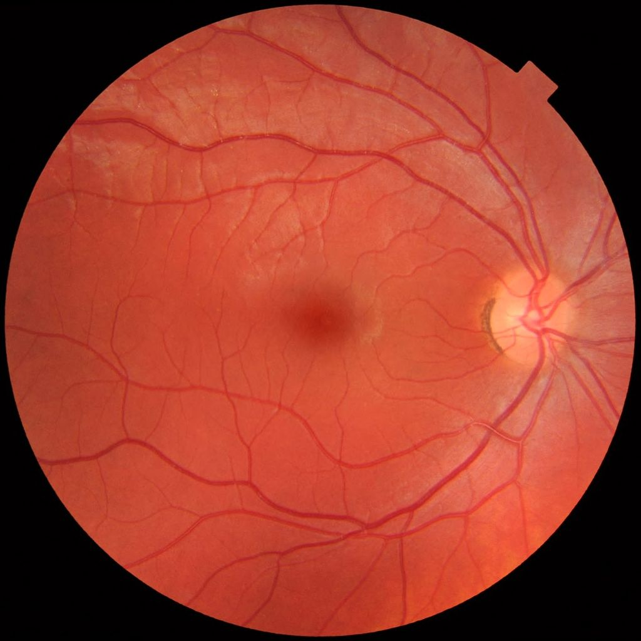
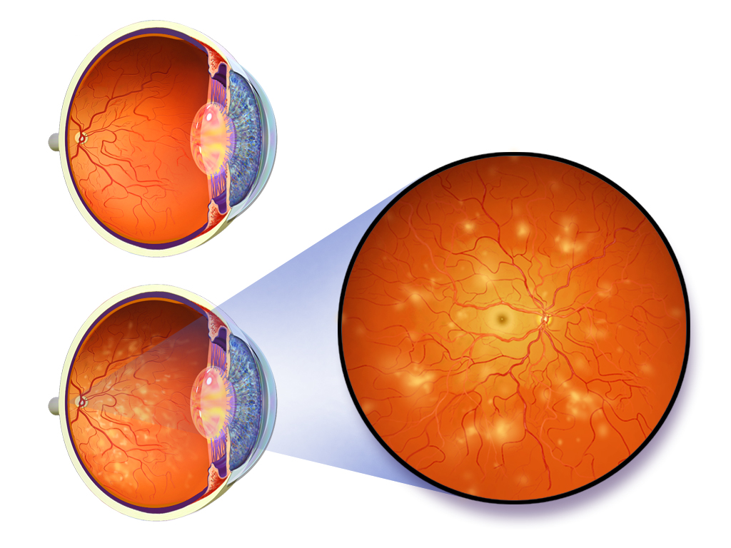
FUNDOSCOPIC EXAM
Normal
Diabetic Retinopathy
Notes:
https://www.google.com/url?sa=i&rct=j&q=&esrc=s&source=images&cd=&ved=0ahUKEwiYppKvwuThAhWNrVkKHecCDf8QMwhqKAAwAA&url=https%3A%2F%2Fgl.wikipedia.org%2Fwiki%2FFicheiro%3AFundus_photograph_of_normal_left_eye.jpg&psig=AOvVaw2uWGhLiUcnxrLF4KO-qNhl&ust=1556050608079314&ictx=3&uact=3
https://www.google.com/url?sa=i&rct=j&q=&esrc=s&source=images&cd=&ved=0ahUKEwiYppKvwuThAhWNrVkKHecCDf8QMwhtKAMwAw&url=https%3A%2F%2Fcommons.wikimedia.org%2Fwiki%2FFile%3ABlausen_0312_DiabeticRetinopathy.png&psig=AOvVaw2uWGhLiUcnxrLF4KO-qNhl&ust=1556050608079314&ictx=3&uact=3

Slide 5
PREVENTION
A systematic review of trials for the treatment of diabetic retinopathy found that strict glycemic and blood pressure control were beneficial for the prevention and progression of retinopathy
The effect of angiotensin inhibition on prevention of diabetic retinopathy is unclear
  Some studies have found decreased progression in a manner different from how angiotensin inhibition is known to prevent diabetic nephropathy
It is also unclear if lipid lowering therapy can reduce the risk of retinopathy
Aspirin has ben found to have no effect on prevention of proliferative retinopathy, vitreous bleeding, or visual loss

Slide 6
TREATMENT
Diabetics should all have an annual dilated ophthalmic exam
Non-proliferative diabetic retinopathy:
  Visual loss is primarily 2/2 macular edema or macular ischemia
  Mild and moderate non-proliferative diabetic retinopathy are managed expectantly
  When clinically significant ME develops, intravitreal antivascular endothelial growth factor (VEGF) or laser therapy (focal photocoagulation) are initial treatment options
  High-risk and severe proliferative diabetic retinopathy require panretinal photocoagulation
Proliferative retinopathy with vitreous hemorrhage or retinal detachment and vision loss can benefit from vitrectomy

Slide 7
REFERENCES
Mohamed Q, Gillies MC, Wong TY, “Management of diabetic retinopathy: a systematic review,” JAMA. 2007;298(8):902.
Matthews DR, Stratton IM, et al. “Risks of progression of retinopathy and vision loss related to tight blood pressure control in type 2 diabetes mellitus,” Arch Ophthalmol. 2004;122(11):1631.
Bergerhoff K, Clar C, Richter B. ”Aspirin in diabetic retinopathy. A systematic review.” Endocrinol Metab Clin North Am. 2002;31(3):779.

